Slide 1
Rename
INFO6210
Rename Trading System
Database Implementation
Team members:
Muxi Chen Guowei Jiang
Hanzhang Xiong Runyuan Li

Slide 2
Project Overview
01
02
03
04
05
Objects &
High Level Design
E-R Diagram
Presentation Layer
Data Population
Database Objects

Slide 3
Obejcts & High Level Design
System Objects
The goal of the system is to provide a trading platform where users can make deals with each other.
DataBase Objects
The database consists of separate tables of information that are grouped by common associations within the groups.
All relationships can be selectively defined and combined through specific queries.
Promote effective, secure and reliable information sharing and retrieval
Design Consideration & Approach
Create a database to handle different transactions for users which can be authenticated and managed by administrator.
An order is created when purchaser and seller have agreed on price

Slide 4
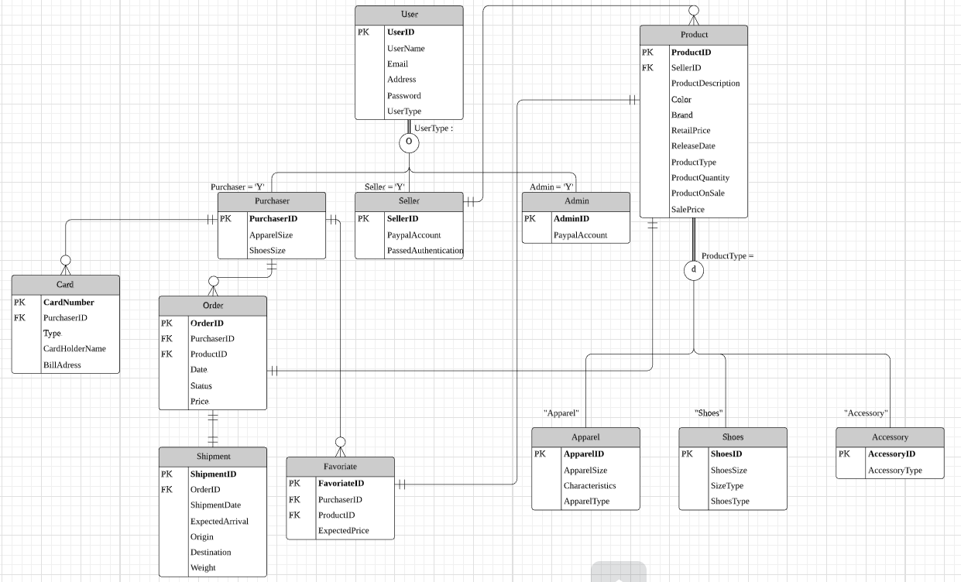
E-R Diagram

Slide 5
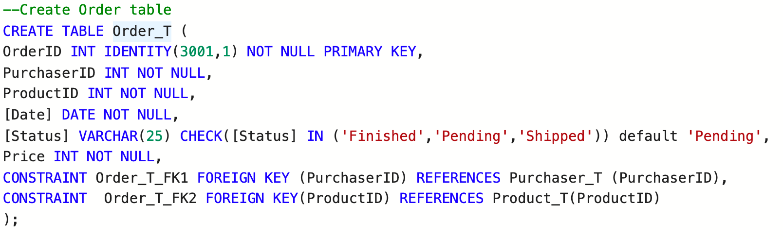
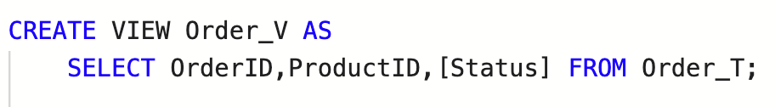
Database Objects
Create Order Tables
Create Order View
Non-clustered Indexes
Notes:
According to the ER Diagram ,we create 12 tables to store data.
We create Views for user table, order table and product table to Submit exactly the data we wish to submit.
We have also created non-clustered indexes for user, order, product, and shipment tables to improve the speed of data retrieval and the performance of the database.

Slide 6
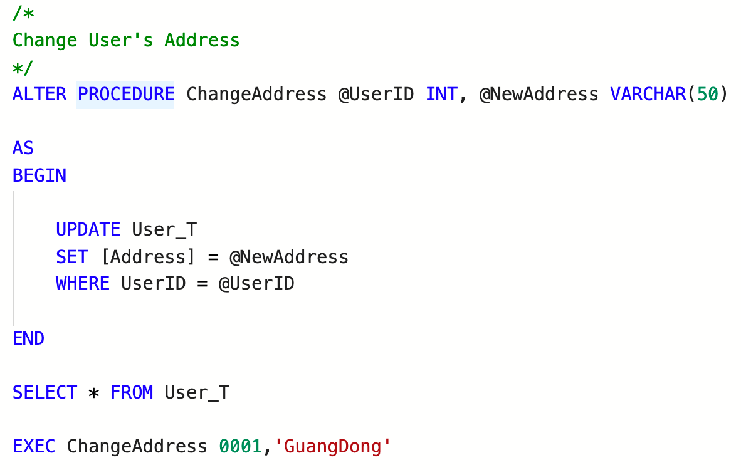
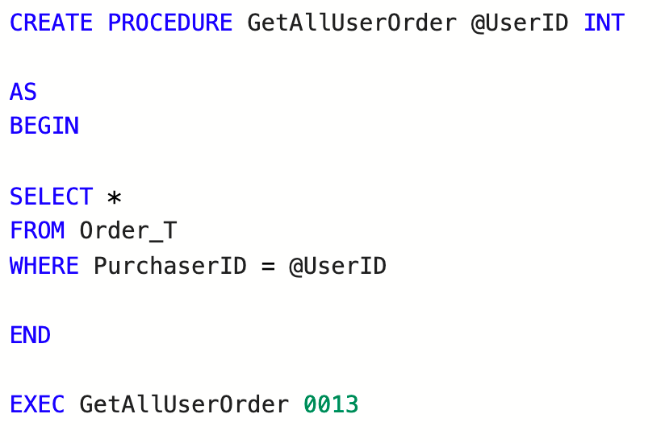
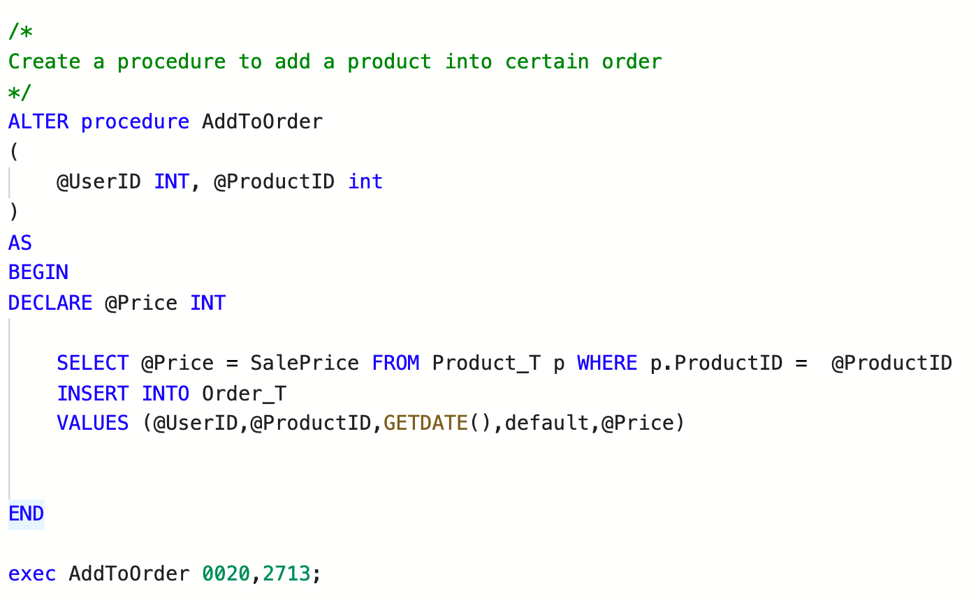
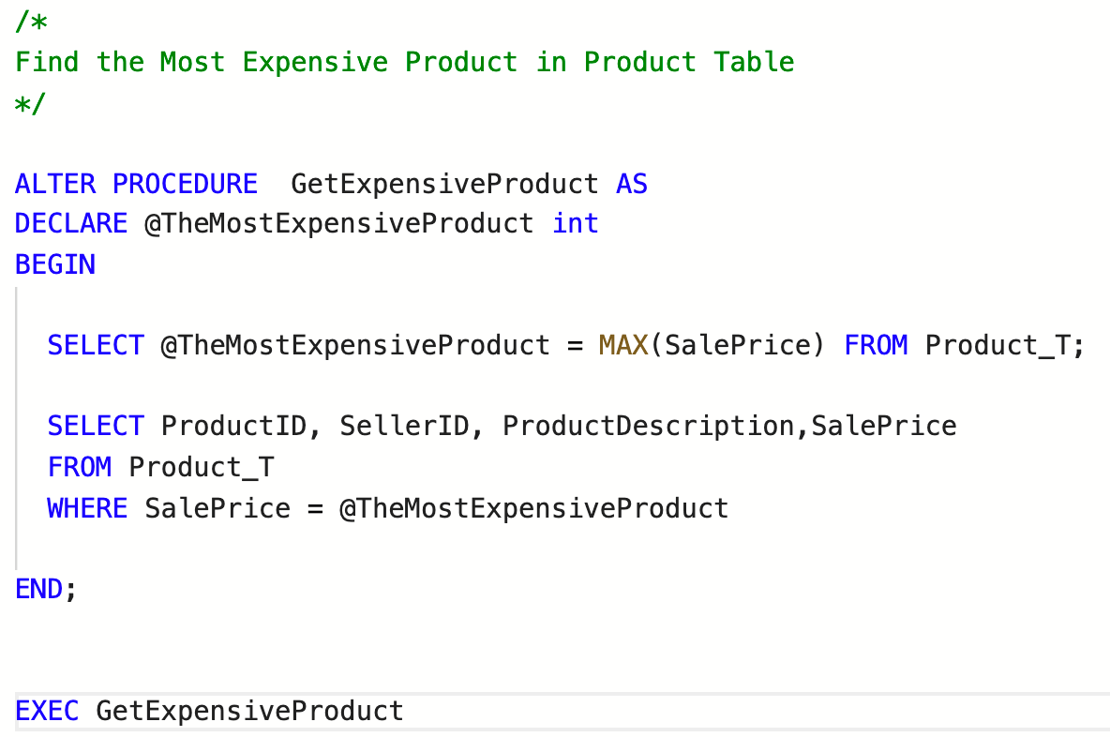
Database Objects - Stored Procedures
Change User's Address
Input an UserID get all orders the user has
Create a new order
Find the most expensive Product
Notes:
We create some Stored Procedures to Change User‘s Address，Input an UserID get all orders the user has, Create a new order and Find the most expensive Product.

Slide 7
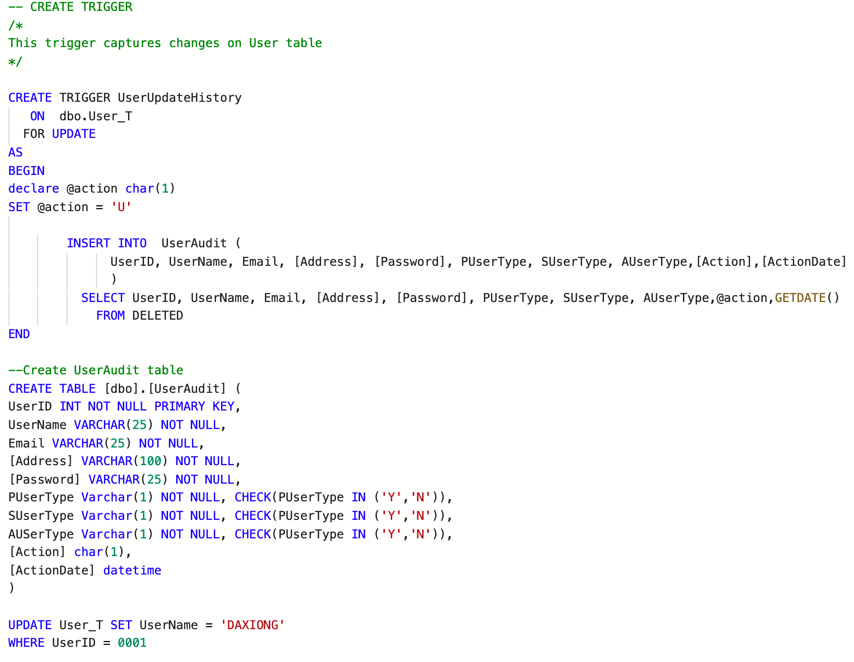
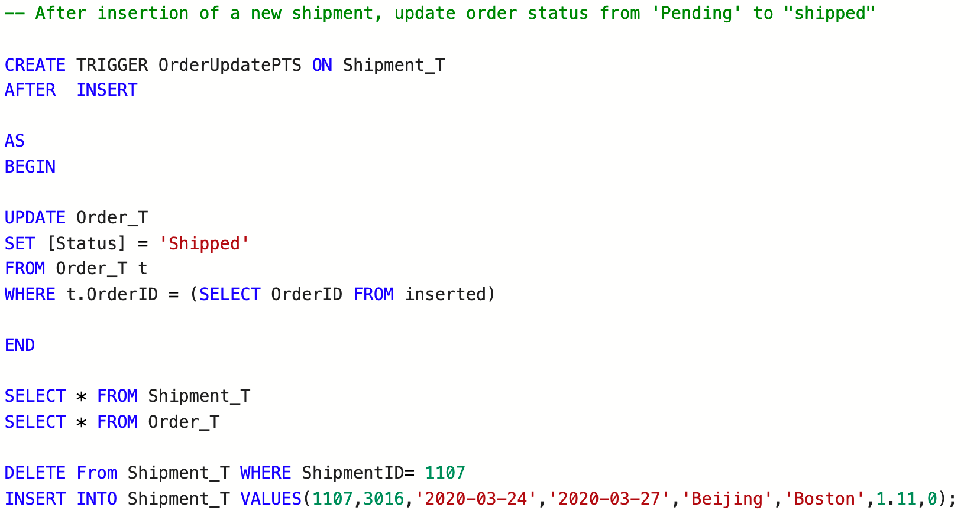
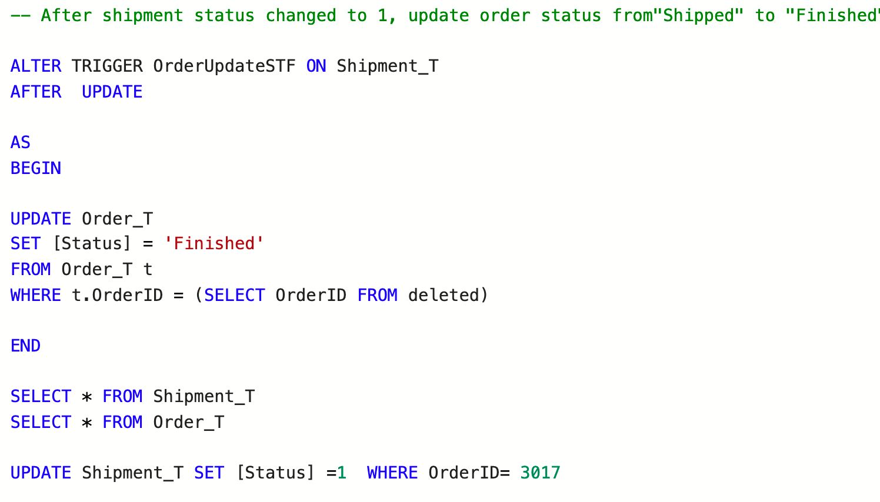
Database Objects - Triggers
Capture Changes on User Table
Update Order status according to Shipment
“Pending” to “Shipped”
“Shipped” to “Finished”
Notes:
We create triggers to capture changes on user table, When the user table changes, it will automatically record the change in the user audit table and record the time of change.
Also we create two triggers to update order status.
After insertion of a new shipment, update order status from 'Pending' to "shipped"
After shipment status changed to 1, update order status from "Shipped" to "Finished"

Slide 8
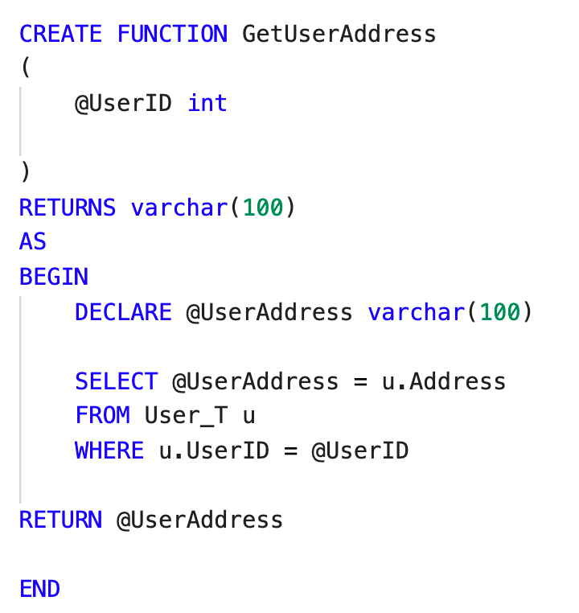
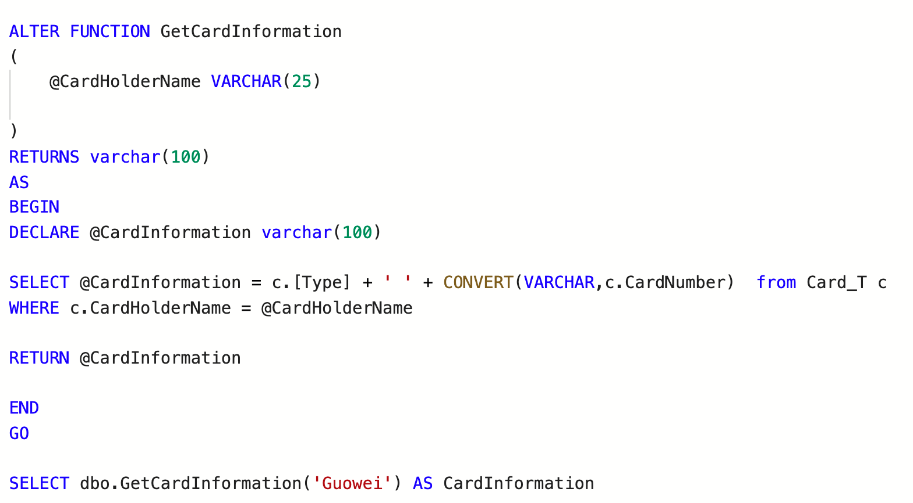
Database Objects - Functions
Get Address with UserID
Get Card Information with CardHolderName
Notes:
Input UserID output User's Address
Input CardHolderName output Card Type + Card Number

Slide 9
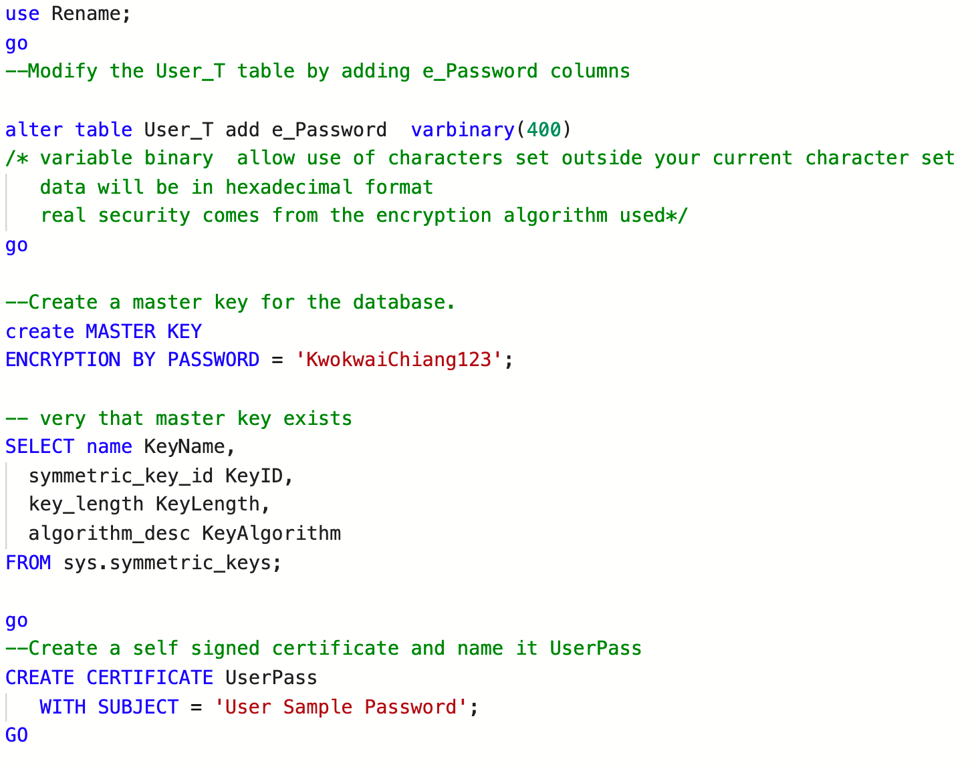
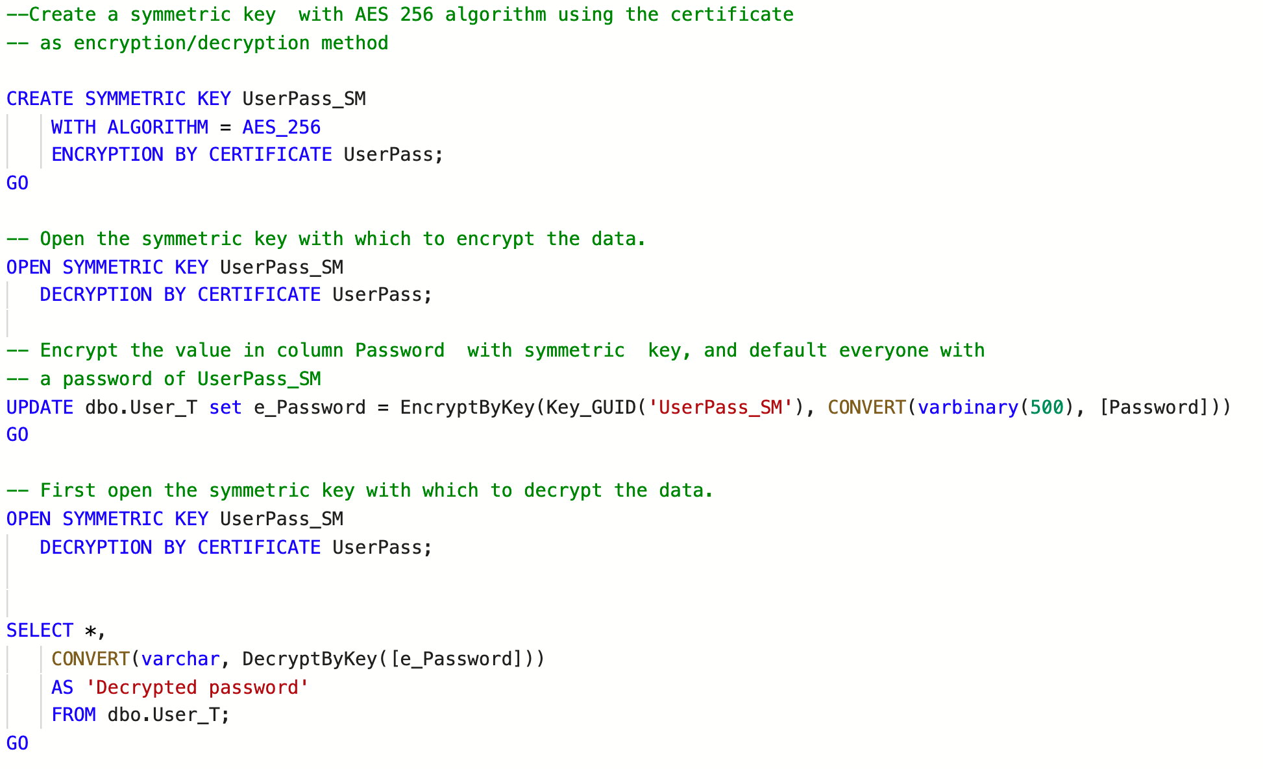
Database Objects - Encryption

Slide 10
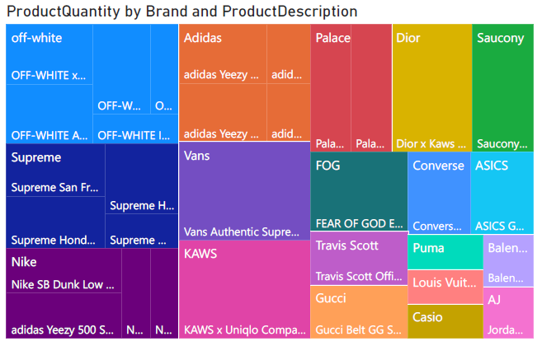
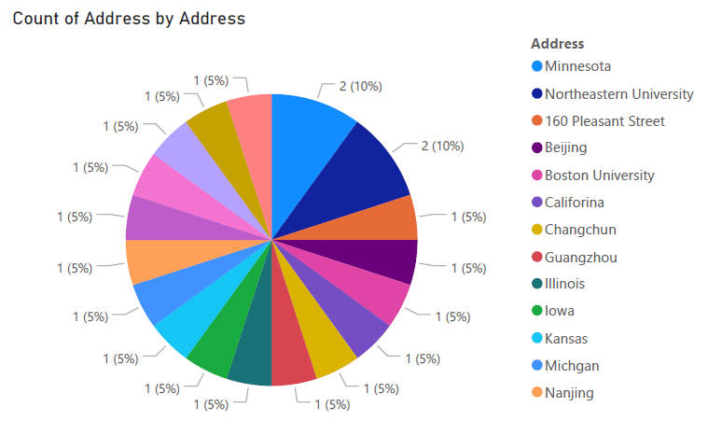
Presentation Layer - PowerBI Reports
Distribution of Product Brands and Details
Count of Different User's Address

Slide 11
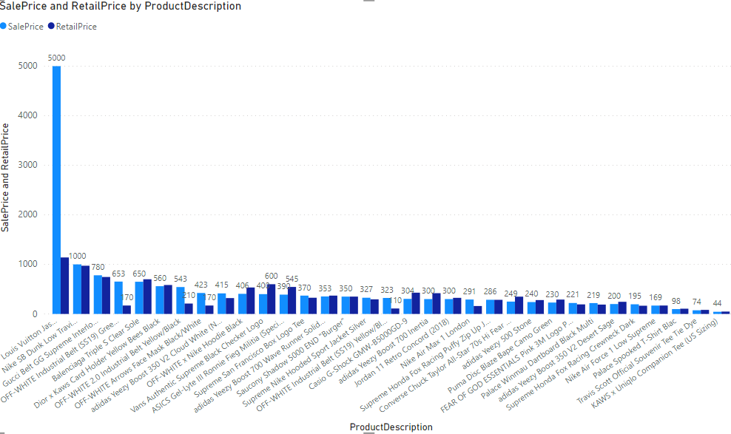
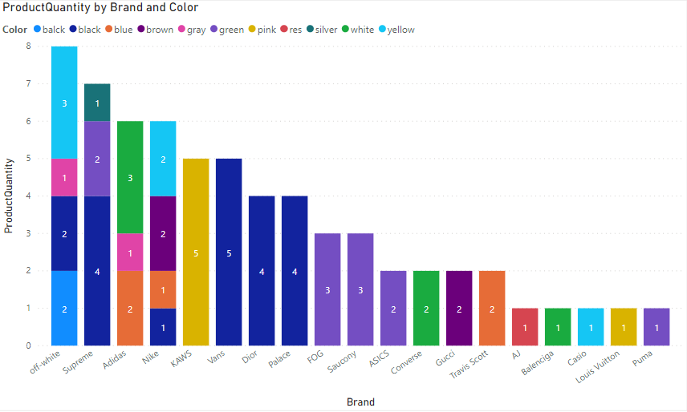
Presentation Layer - PowerBI Reports
Distribution of Products' SalePrice & RetailPrice
Count of Products by Brand and Colors

Slide 12
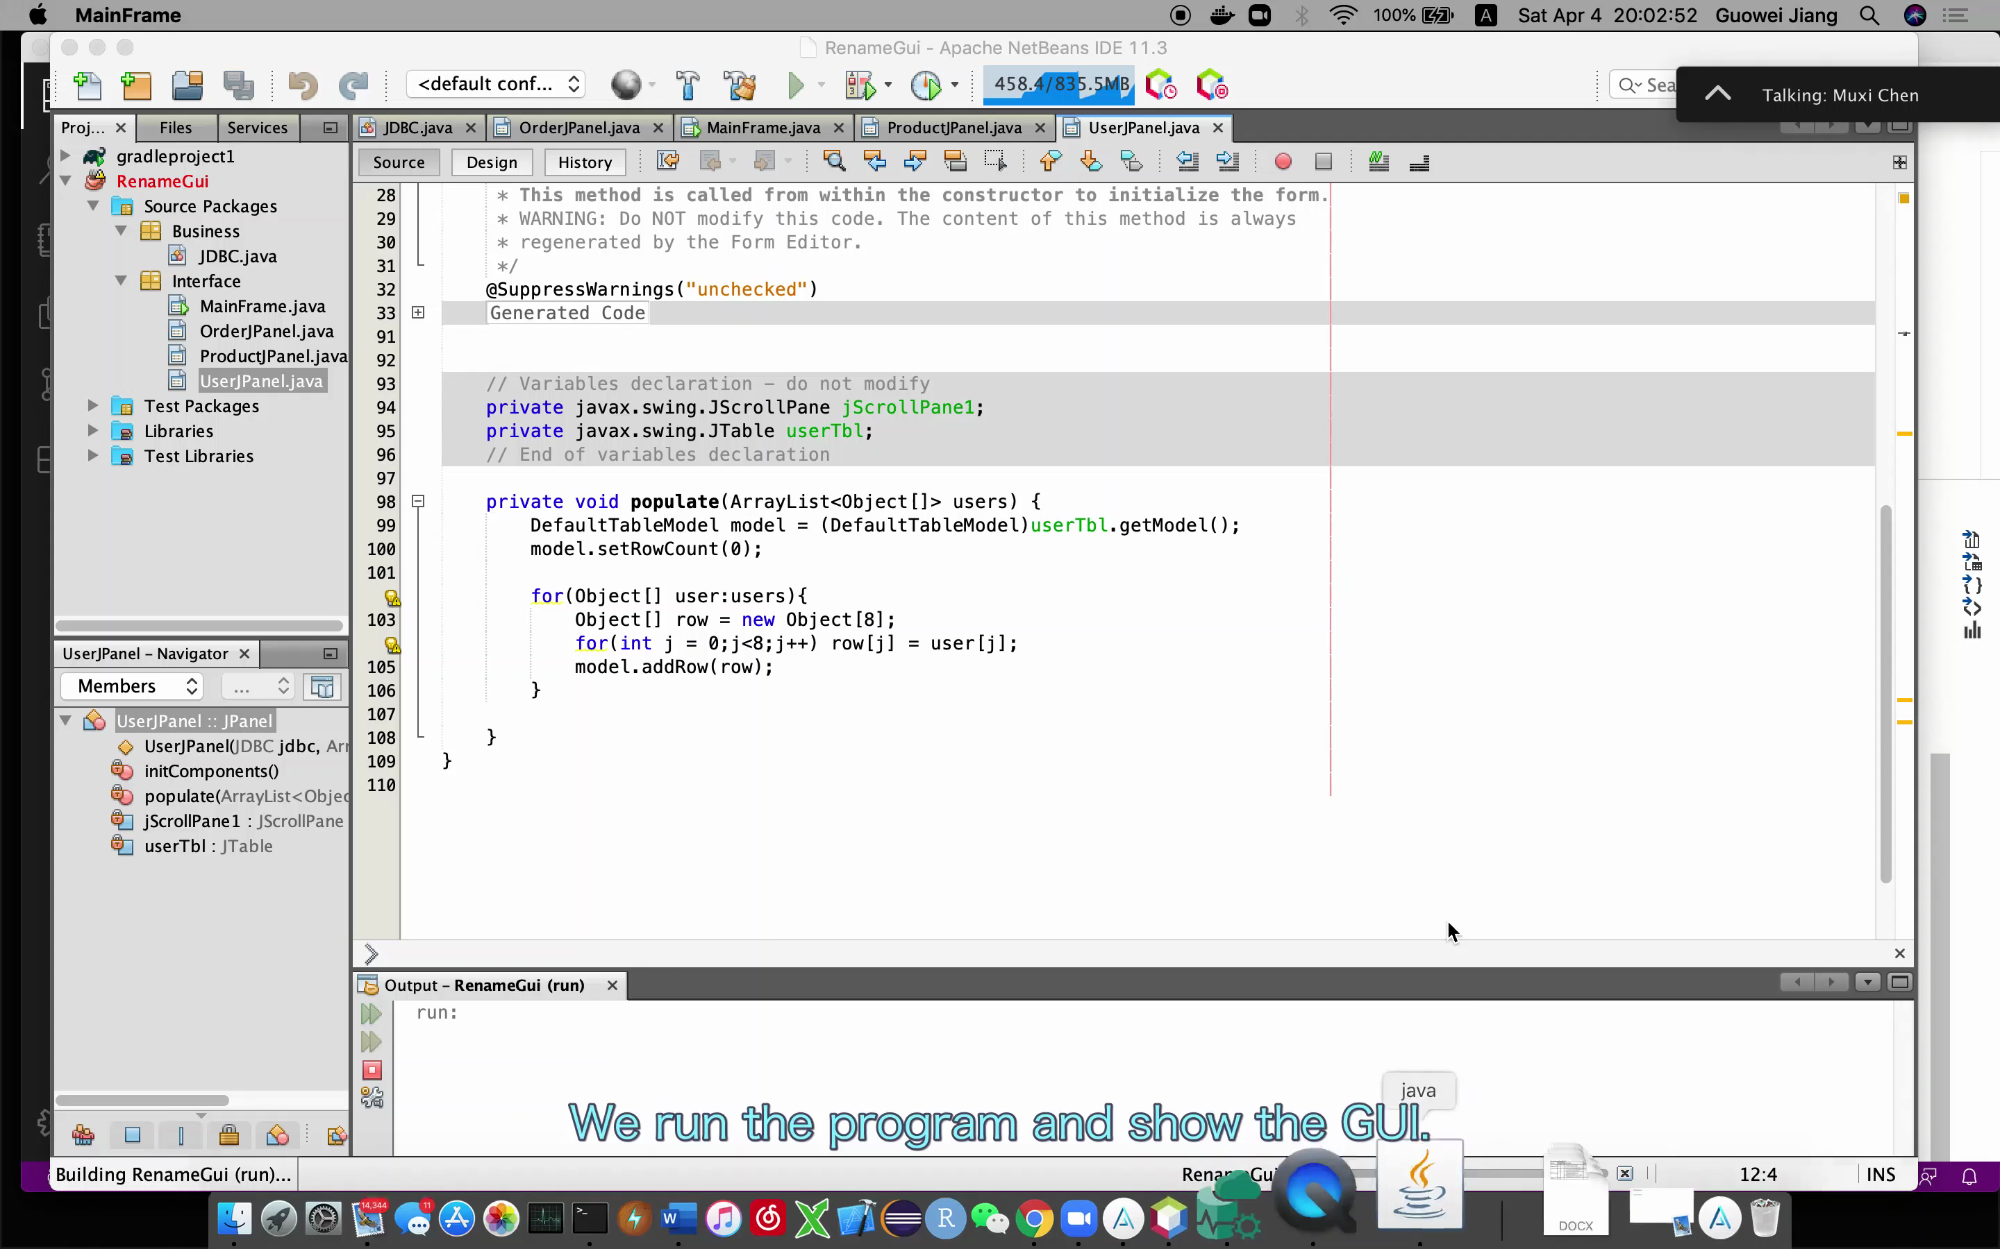
Presentation Layer - GUI

Slide 13
Data Population
10
10
36
20
20
20

Slide 14
Data Population
10
10
20
16
20
10

Slide 15
Rename
Thanks For Listening

